Slide 1
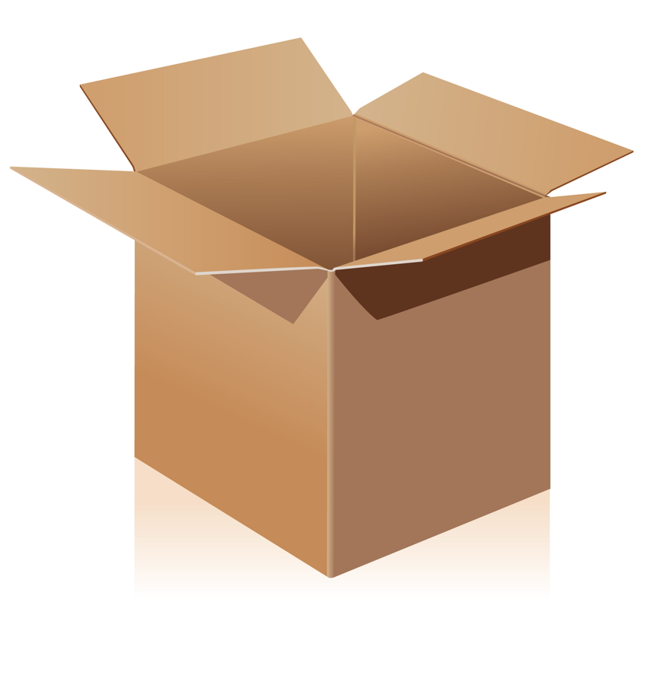
Variables
When programming it is often necessary to store a value for use later on in the program.
A variable is a label given to a location in memory containing a value that can be accessed or changed.
Name
Think of a variable as a box with a label that you can store information in.

Slide 2

Example
Match the Python code to the correct part of the flowchart.
Start
Input Name
Display “Hello “ + name
End
Create a Python program based on the code above and save it as variables.py. Press F5 to run it.

Slide 3
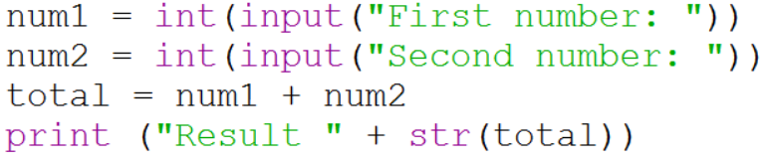
Inputting Numbers
When inputting numbers into variables you need to tell Python what data type to expect.
We use int to tell Python we are going to enter an integer (whole number). We use float when working with decimal places.
We use str to convert a number into a string.
Create a new program using this code and save it as numbers.py.

